Slide 1
Overview of Intermachine Communication
There are 2 important stages that encompass the communication between the Android Application ,Bank Server and Subsidiary Servers. These are as follows:
OTP Generation and Verification
Passing OTP, Login Id and Password for Retrieval/Splitting
Each of these 2 stages are called in each of the 2 processes of the Bank Cryptosystem we are trying to implement. The 2 basic processes are as follows:
Signup/Registration (Splitting)
Login (Retrieval)

Slide 2
The 2 communication diagrams here please

Slide 3
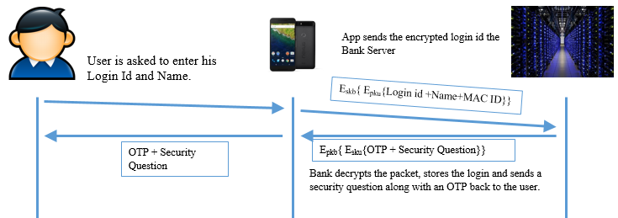
OTP Generation and Verification Overview
The OTP is sent via Sockets. A TCP Socket is opened at the Application Side and the Bank Side. Packet sent to Bank Server and Reply from the app is got over the same line
Implementation Details :
Port:9999
IP Address of Bank Server: 192.168.43.226

Slide 4

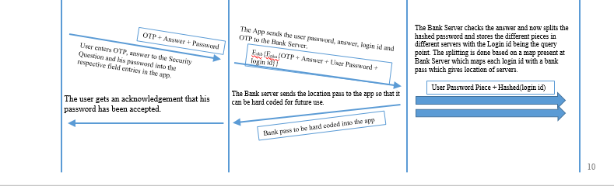
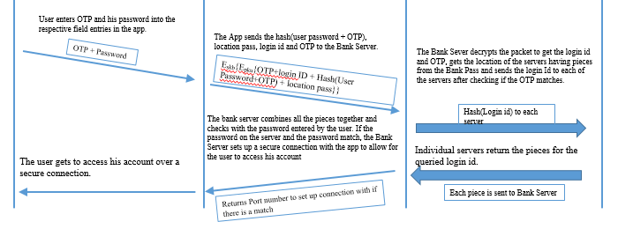
Passing OTP, Login Id and Password for Retrieval/Splitting
Implementation Details:
Port: 9999
Port between Subsidiary and Bank for Sending: 8888
Port between Subsidiary and Bank for Receiving: 7777
IP Address of Bank Server:192.168.43.226

Slide 5
Data Serialization during transmission
Data sent through Sockets are Serialized.
Data is serialized to JSON during transmission from App to Bank Server, and pickled during transmission from Bank to Subsidiary Servers.
JSON (Java Script Object Notation) is built on the following:
A collection of name/value pairs. In various languages, this is realized as an object, record, struct, dictionary, hash table, keyed list, or associative array.
An ordered list of values. In most languages, this is realized as an array, vector, list, or sequence.
The pickle module implements a fundamental, but powerful algorithm for serializing and de-serializing a Python object structure. “Pickling” is the process whereby a Python object hierarchy is converted into a byte stream.

Slide 6
Socket implementation on Android - Asynctasks
AsyncTask enables proper and easy use of the UI thread. This class allows you to perform background operations and publish results on the UI thread without having to manipulate threads and/or handlers.
AsyncTask is designed to be a helper class around Thread and Handler and does not constitute a generic threading framework.
AsyncTask enables running on a single UI thread thereby increasing security.
However multiple AsyncTask running on a single UI thread cause strain on the main thread.

Slide 7
Output here please
Take it from the earlier phase presentation… Its ok

Slide 8
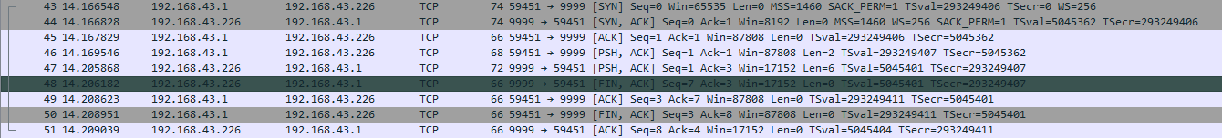
Statistics for Packet Transmission
OTP Generation and Validation during Signup (0.043 seconds)

Slide 9
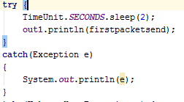
Statistics for Packet Transmit between Bank Server and Split Server (0.45 seconds)
Statistics for Packet Transmit during Login
Here there is a 2 second delay which has been introduced during the sending of the packet due to the fact of calling Asynchronous Tasks on the main thread.
This has been shown in the code given in the left.

